Slide 1
Introduction to Deep Learning
Adam Rauff

Slide 2
Outline
Neural Network Basics
Example Backprop
Keras programming

Slide 3
Supervised Learning
X
Y
Input
Outout
Cat
2

Slide 4
Applications
Computer Vision
Image classification
Object localization
Posture
Segmentation
Speech Recognition
Natural Language Processing

Slide 5
Other Learning?
Reinforcement Learning
Unsupervised Learning
Semisupervised Learning

Slide 6
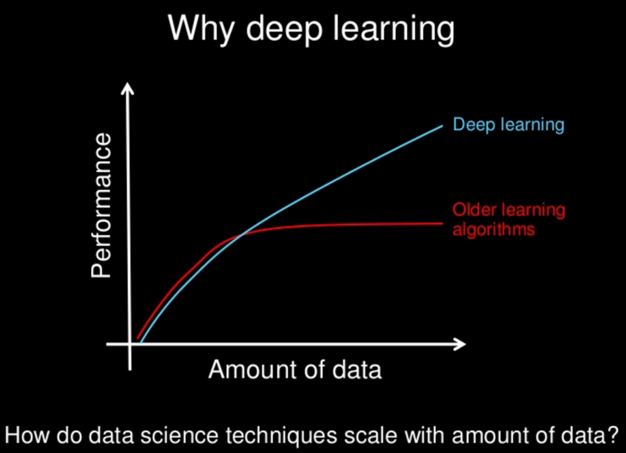
Why Deep Learning?
Already have classification / regression algorithms
Support Vector Machines
Logistic Regression
Linear / nonlinear regression
Scales better to larger dataset
The field is as much experimental as it is theoretical

Slide 7
Why has Supervised Learning gained so much attention?
More Data
More computational resources
Better algorithms?
Perceptron
1950s
Backprop
1970s
Popularized by Hinton in 1980s
LeNet: Conv Nets
1998
LeCun and Bengio
Deep Belief Nets
2006
Hinton
Notes:
Make sure to mention AlexNet

Slide 8
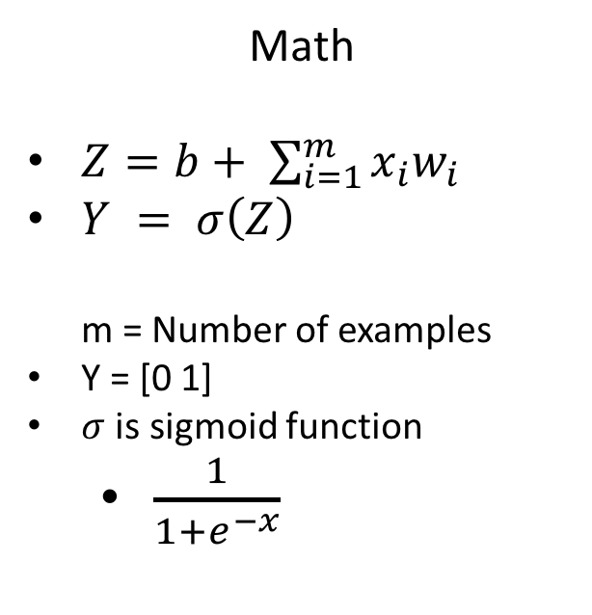
Perceptron
Representation
Math
$Z=b+ \sum_{i=1}^{m}{x_{i}w_{i}}$
$Y = σ\left(Z\right)$ m = Number of examples
Y = [0 1]
$σ$ is sigmoid function
$\frac{1}{1+e^{−x}}$

Slide 9
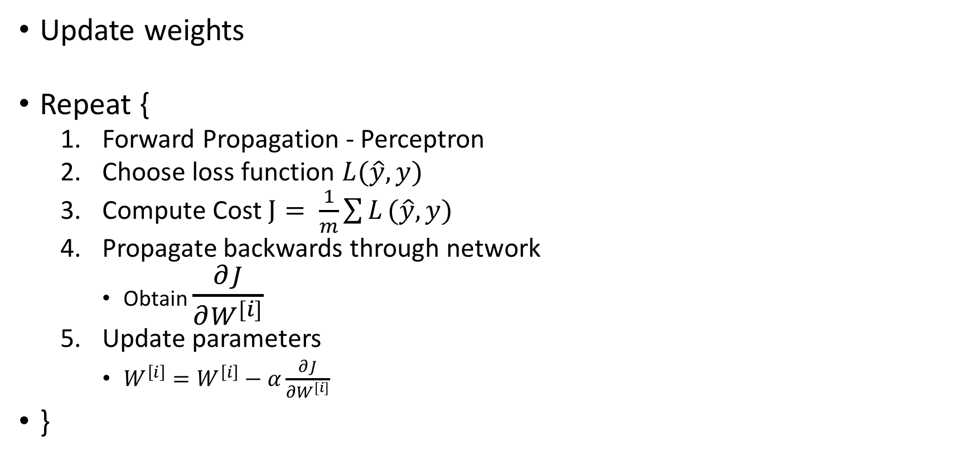
Backpropapgation
Update weights
Repeat {
Forward Propagation - Perceptron
Choose loss function $L(\hat{y}, y)$
Compute Cost $J= \frac{1}{m}\sum{L}(\hat{y}, y)$
Propagate backwards through network
Obtain $\frac{∂J}{∂W^{[i]}}$
Update parameters
$W^{\left[i\right]}=W^{\left[i\right]}−α\frac{∂J}{∂W^{[i]}}$
}

Slide 10
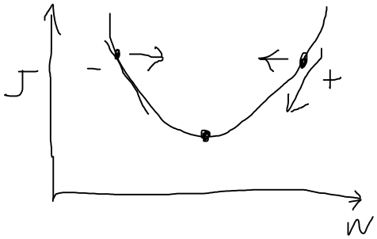
Intuition

Slide 11
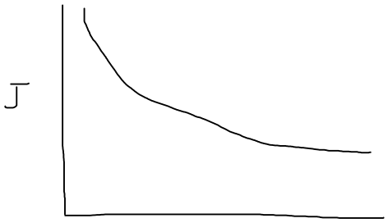
How long to repeat?
Iterations
Notes:
Mention Batch Gradient Descent and Stochastic Gradient Descent

Slide 12
Miscellaneous
Train / Test split
Normalization
Normalize input data
Batch Normalization
Weight initialization
Vectorization – go over size of parameters along network?
Activation Functions - nonlinearity
Leaky ReLu
ReLu
Tanh
sigmoid

Slide 13
Example
Backpropagation example
Mnist data set with keras

